Slide 1
Final Sprint
Abstractive Conversation Summarizer With Open Source AI Tools (ACSWOSAT)
Akshat Baranwal, Cameron Caruso, Mark O'Connor, Michael Provenzano, Parth Dalwadi, Steven Warner
Dr. Neil Toporski (Faculty Advisor)
Client : Impact Intell
Notes:
Good Afternoon Everyone

Slide 2

Agenda
Problem Introduction
What We Accomplished
What We Didn’t Accomplish
Project Overview
Methodology
Burn-Up Chart
Sprint Backlog History
Demonstration
Q&A

Slide 3


Problem Introduction
Information Silos

Slide 4

Accomplishments
Developed an abstractive summarization tool for law enforcement agencies.
Saves valuable time and resources by quickly summarizing text channels and downloading PDF files of the summary.
Utilized open-source Python tools and advanced machine learning models for accuracy and reliability.
Highly accurate and reliable tool ensures an accurate representation of the text channel being summarized.

Slide 5

Things we didn’t accomplish!
Could not reliably reproduce summary that is about 40% of original length.
Encountering memory limitations during training process.
It's difficult to find big sets of data that are related to what we're trying to do.

Slide 6

What Is Our Product?
Our product is a machine learning powered summarization tool.

Slide 7



Methodology
Hugging Face

Slide 8
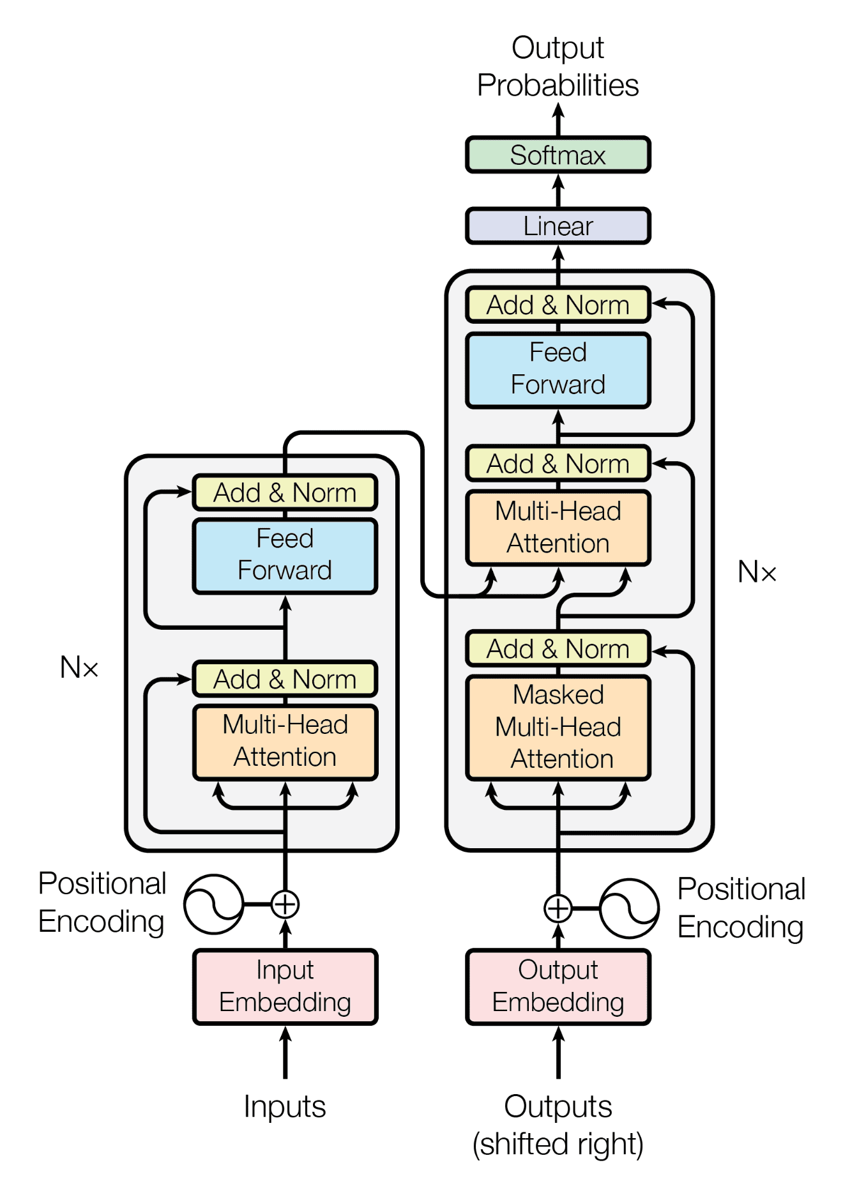
Transformer
Good Performance on Sequential Data
Attention Mechanism
Transfer Learning
Versatile

Slide 9
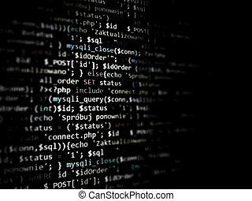
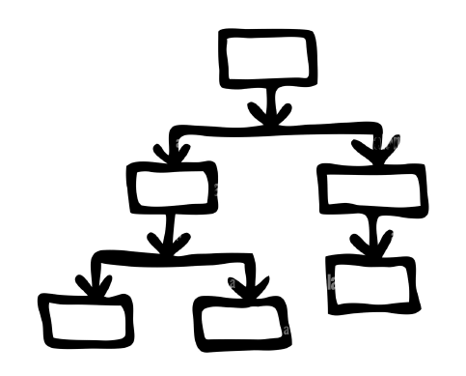
Decision Tree

Slide 10
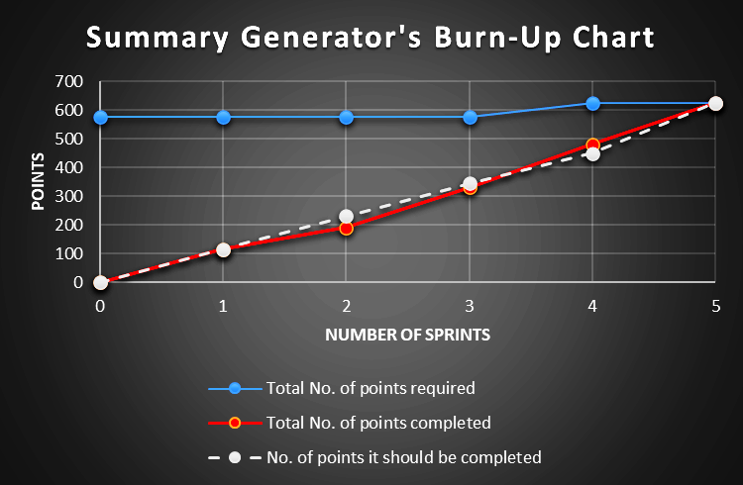

Slide 11
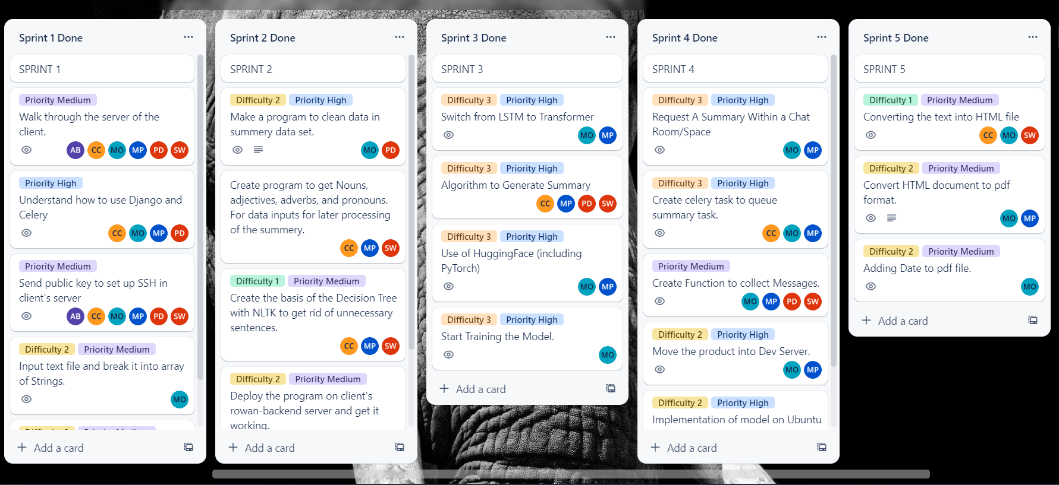
Backlog History

Slide 12

Use and User Experience
Information Sharing
Information Seeking

Slide 13

Step by Step
User request a summary
Channel and User keys
Message Query
Reformat
Decision Tree
Transformer
Html to PDF
Post

Slide 14

Demo

Slide 15
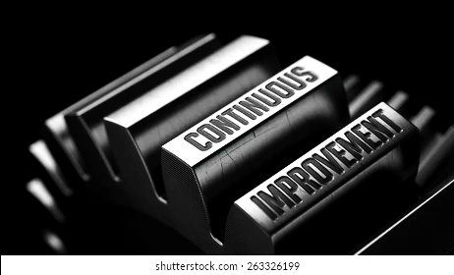
Improvements
More Training
Better Datasets

Slide 16

Q & A

